Slide 1

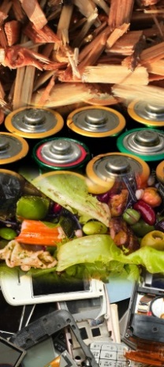







9th International Conference on Engineering
for Waste and Biomass Valorisation
June 27-30, 2022
Copenhagen, Denmark
Experimental study of the use dredged sediments in a hydrocarbon matrix
Fouad BELAYALI, Walid MAHERZI, Nor-Edine ABRIAK, Mahfoud BENZERZOUR
^{1.} Univ. Lille, IMT Nord Europe, Univ. Artois, JUNIA, ULR 4515 - LGCgE, Laboratory of Civil Engineering and Geo-Environment, F-59000, Lille, France;
www.wasteeng.org
logos
Notes:
Good morning ladies and gentelmen
My name is Walid Mhaerzi, i am an assistant professor at IMT Nord Europe in France, i would like first to express my plaisir to particpate in this very interessting conference concerning waste and biomass valorisation
today i am gonna talk about the USE OF TERNARY BINDER BASED ON CLAYEY CALCINED SEDIMENTS FOR THE STABILIZATION OF MINERAL WASTE, it is a part of reaserch thesis of Selma BELLARA

Slide 2
2
Summary
01
Background and study objectives
02
Materials and research methodology
03
Results
Conclusions and perspectives
04
Notes:
This is the outline of the presentation
First i will begin by a background and study objectives
Followed by the research methodologie,
Experimental approach
And i will finish with some conclusions and future work

Slide 3
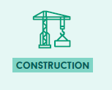
3
Background and study objectives
Waste production in France
In 2016, we produced 326 Mt of waste
224 Mt from the construction & public works sector
4,6 tonnes of waste per capita/year
Fortunately, some industries use secondary raw materials (alternative materials) in their activities: 66% for the paper industry, 58% for the glass industry, 50% for the steel industry and 6% for plastics and 27% for construction sector.
Sources : Eurostat – Production de déchets des entreprises 2006 à 2016 ;
ADEME – Enquête Collecte 2015 ;
ADEME – Bilan du recyclage 2005-2014 ;

Slide 4
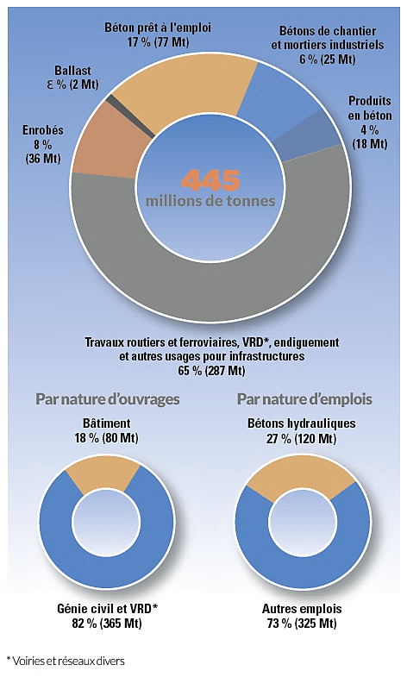
4
Background and study objectives
Use & Needs of aggregates in France
321.5 Mt aggregates extracted from quarries
121.5 Mt aggregates from recycling
2.2 Mt imported from outside
6 tones per capita per year and 17 kg per capita per day
UNICEM - Union nationale des industries de carrières et des matériaux de construction 2018
Notes:
On the other hand, Huge amounts of mineral waste are produced each year.
One such waste is dredged sediments:
The main water resource is based on the exploitation of hydraulic dams. Algeria has about 74 dams in service, the siltation rate of these dams was estimated about 65 million m3 in 2017 compared to 45 million cubic meters in 2006, a loss of 20% of their initial capacity.
Dredging operations are therefore essential in order to restore the initial water production capacity.
Blast furnace slag and marble waste are also another type of waste wich are found in abundant quantities in the East of Alegria

Slide 5
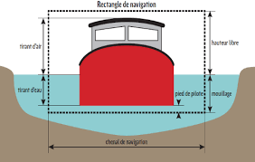
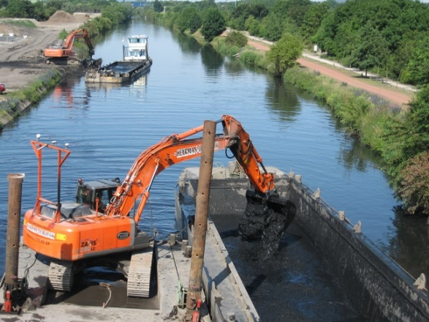






5
5
Background and study objectives
Dredging sediments
Sediments are a fine particles (clays, silts) or coarse particles (sands), displaced and transported by climatic actions (wind, tides, ...) and human (development work, soil exploitation, ...).
Sediments are considered waste when they are extracted from water
?
Storage
Immersion
Valorisation
Notes:
Turning now to the study methodology
a mix design was built for the optimization of ternary binders based on cement, GGBS and calcined sediments.
The Design expert software was used here to evaluate the effect of input parameters on the output parameters (wich is here the compressive strength of the mortar after 28 days).
The experimental design space obtained is shown in the figure. The red dots represents the proposed formulations.
11 mixtures were formulated with a water cement ratio of 0.5 and then tested for mechanical strength.
The most suitable regression model (quadratic regression ) was chosen for the prediction of compressive strengths.
The two formulations 80 Cement 10 Slag 10 Calcined Sediments and 50 Cement 35 Slag 15 Calcined Sediments were selected to validate the quadratic model

Slide 6
Background and study objectives
6
Potential applications for the valorization of sediments in building materials
Lightweight aggregates
Concrete and cement
Bricks and tiles
Sealing asphalt
Previous applications
Intended Application
Road construction
Dike

Slide 7
7
Background and study objectives
What is a sealing asphalt ?
Composition
Benefit
42% by mass
Self compacting
Bitumen
LS Filler
Porphyry
Sand
Waterproof
None voids
Punctual repairs
Ecological
Durability
Appearance and special aspect

Slide 8
8
Background and study objectives
Applications of sealing asphalt
Bridge
Industrial soil
Road
Parking
Tank
Reparation
Bicycle path
Walkways

Slide 9
9
Background and study objectives
Valorisation of mineral wastes in asphalt materials
Powder of glass
Powder of bricks
Fly ash
Rice husk ash
Powder of marble
sawdust
Powder of ceramic

Slide 10
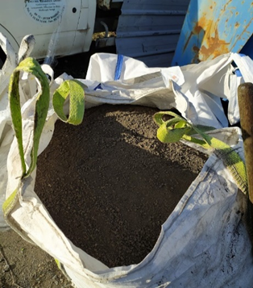
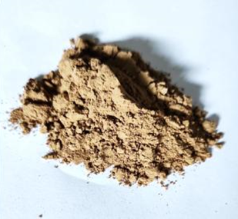

10
Background and study objectives
Valorisation of mineral wastes in asphalt materials
Bitume
Filler
Porphyre
Sable
Raw sediments
Pretreatment
Mix optimization
Physical
Grinding
Chemical
CaO
Thermal
Flash Calcination

Slide 11
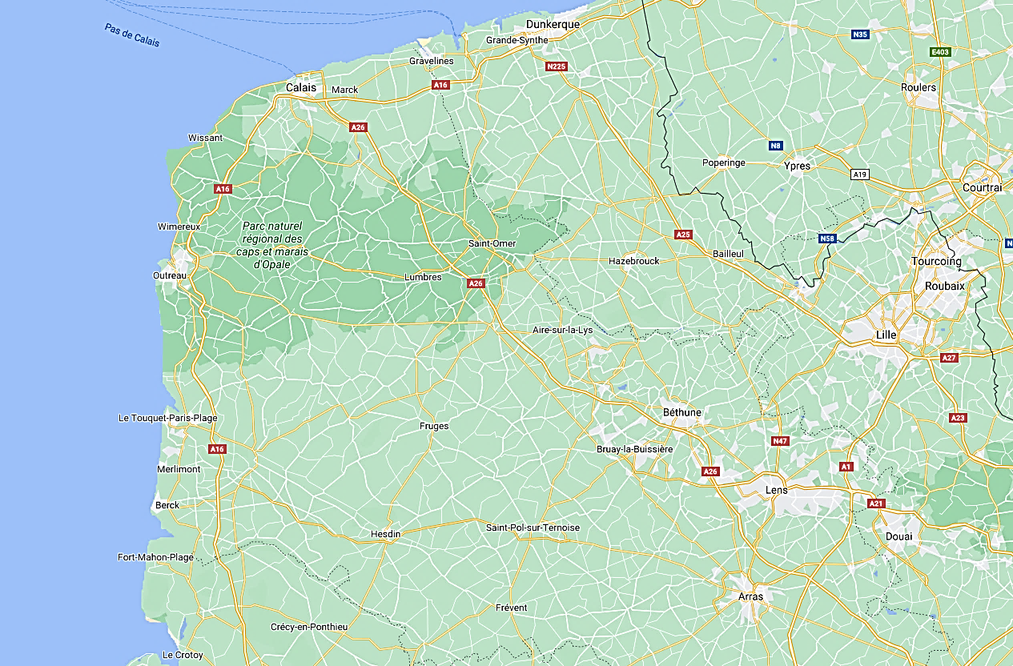
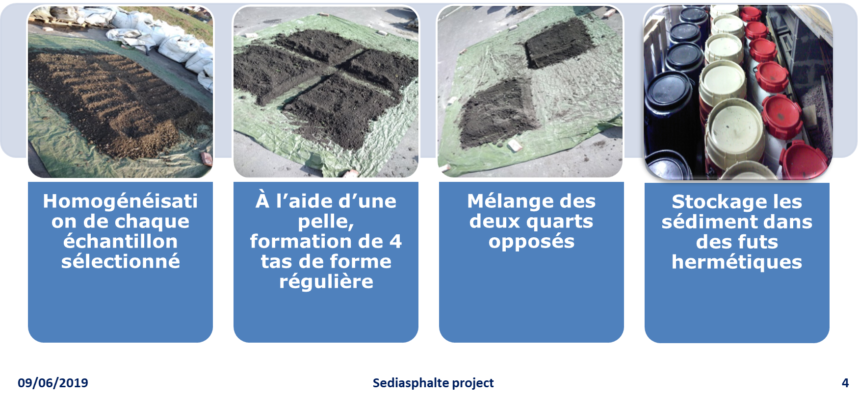
11
Materials and research methodology
Materials
Sediments were collected from different rivers on the north of France
Noyelles-sous-Lens (NSL)
Aire-sur-la-Lys (ASL)
European Metropolis of Lille (MEL)
Urban Community of Arras (ARS)
Homogenization and subsampling

Slide 12
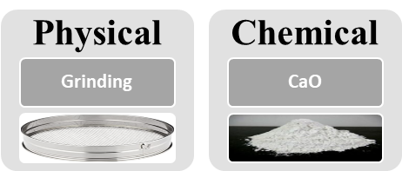
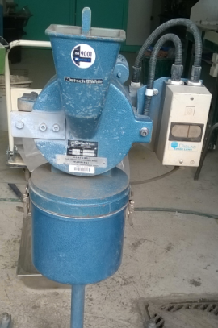
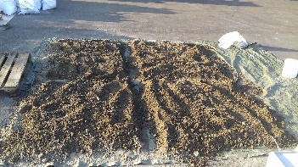
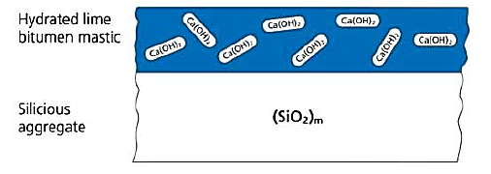
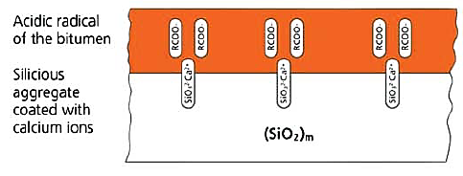
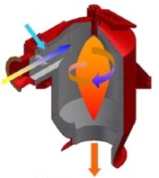

12
Materials and research methodology
Pre-treatment of the sediments
Ishai and Craus (1977).
Thermal
Flash Calcination
Time :
2 à 3 secs
Spherical form

Slide 13
13
Materials and research methodology
Environmental characterisation
Paramètre | Unité | Inert | Non hazardous |  | CU-Arras | ASL | MEL | NSL
matière sèche | % massique | <30 |  |  | 67,3 | 85,6 | 95,6 | 65,6
TOC | mg/kg MS | 30 000 | 50 000 |  | 37 200 | 27 000 | 73 000 | 90 000
BTEX | mg/kg MS | 6 | 30 |  | 0,25 | 0,3 | 0,25 | 2
PAH (16) - EPA | mg/kg MS | 50 | 100 |  | 4,4 | 2,87 | 46 | 22
PCB totaux (7) | Mg/kg MS | 1 | 50 |  | 0,013 | 0,05 | 46 | 0,26
Hydrocarbures totaux C10-C40 | mg/kg MS | 500 | 5000 |  | 427 | 1,3 | 505 | 2320
Métaux lourds sur éluats en (mg/kg de matière sèche )
antimoine | mg/kg MS | 0,06 | 0,7 | - |  | <0,03 | 0,14 | 0,09
arsenic | mg/kg MS | 0,5 | 2 | <0,04 |  | 0,34 | 0,05 | <0,05
baryum | mg/kg MS | 20 | 100 | 1,04 |  | 0,35 | 0,35 | 0,43
cadmium | mg/kg MS | 0,04 | 1 | 0,01 |  | 0,01 | 0,004 | 0,01
chrome | mg/kg MS | 0,5 | 10 | 0,02 |  | 0,365 | 0,012 | <0,01
cuivre | mg/kg MS | 2 | 50 | <0,05 |  | 0,37 | 0,4 | 0,28
mercure | mg/kg MS | 0,01 | 0,2 | <0,0005 |  | 0,11 | 0,01 | <0,01
plomb | mg/kg MS | 0,5 | 10 | <0,1 |  | 0,49 | 0,1 | <0,1
molybdène | mg/kg MS | 0,5 | 10 | 0,05 |  | 0,049 | 0,063 | 0,11
nickel | mg/kg MS | 0,4 | 10 | 0,02 |  | 0,16 | 0,1 | 0,13
sélénium | mg/kg MS | 0,1 | 0,5 | <0,039 |  | 0,022 | 0,039 | 0,05
zinc | mg/kg MS | 4 | 50 | 0,09 |  | 1,85 | 0,21 | 1,2
Autre paramètre sur éluats
TOC | mg/kg MS | 500 | 800 | 82 |  | 47 | 94 | 94
Indice phénol | mg/kg MS | 1 | 10 | <0,1 |  | - | <0,1 | <0,1
chlorures | mg/kg MS | 800 | 15000 | 42 |  | 55,46 | 24 | 20
sulfate | mg/kg MS | 1000 | 20 000 | 930 |  | 552,3 | 554 | 5350
The ASL sediments was classified as Inert waste
ARS, MEL and NSL sediments were considered as Non-hazardous non-inert waste

Slide 14
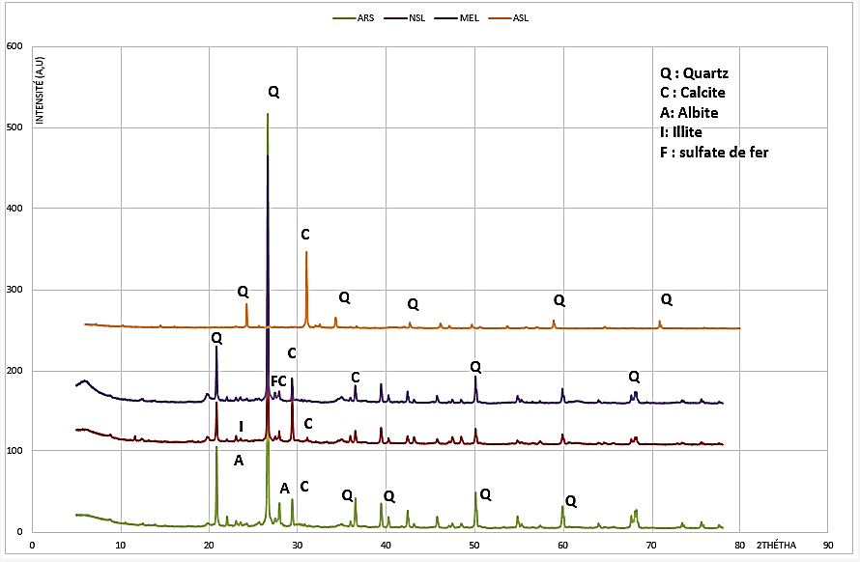
14
Materials and research methodology
Mineralogical characterisation
Oxyde | NSL | ASL | ARS | MEL | LS
Al₂O₃ | 13,42 | 11,9 | 10,96 | 11,15 | 0.14
SiO₂ | 37,01 | 59,26 | 59,68 | 51,98 | 0.47
CaO | 19,87 | 9,51 | 9,65 | 13,29 | 98,33
The sediments are composed mainly of quartz (SiO₂) and calcite (CaCO₃)

Slide 15
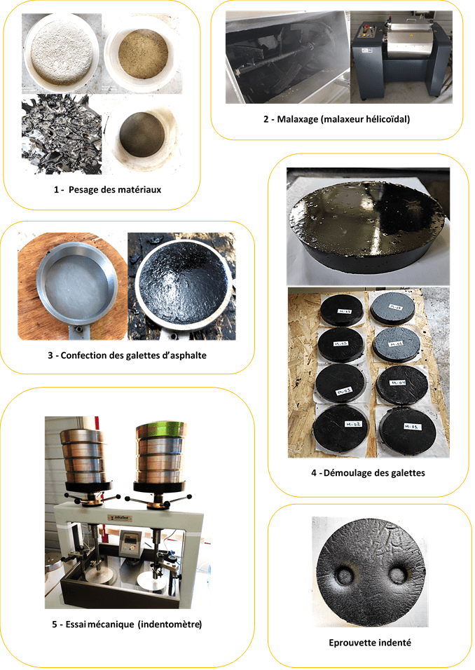
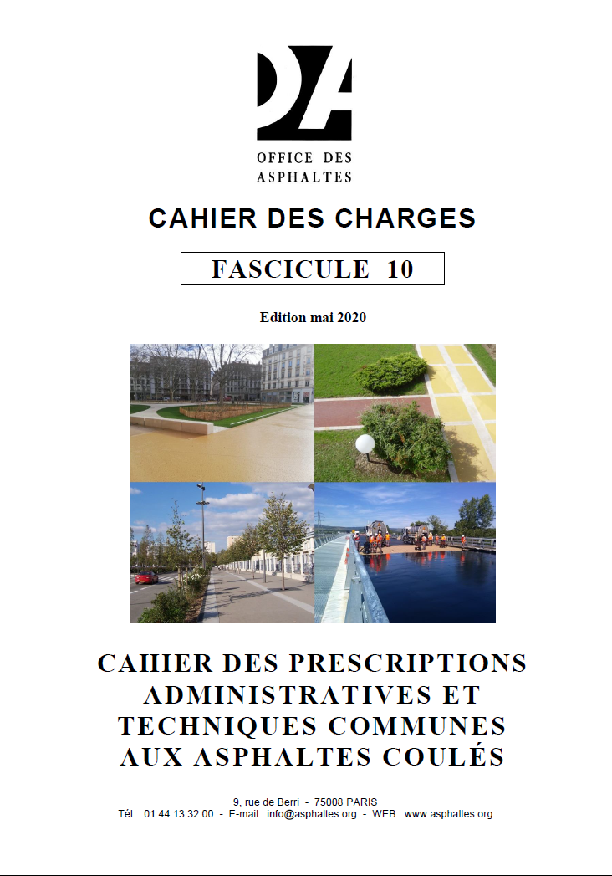
15
Materials and research methodology
Specifications
Glass of Bitumen - Penetration NF EN 1426 1/10 mm ≥ 35
Bitumen after extraction 16 - 22 %
Fines after extraction ≥ 45%
Indentation NF EN 12697fabricationtype a :70 ≤ i ≤ 100
Maximal temperature of fabrication : ≤ 200 °c

Slide 16
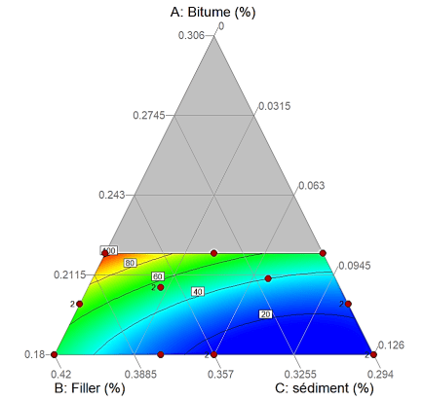
16
Materials and research methodology
Mix design (Design-Expert software)
Comp. | Name | Units | Type | Minimum | Maximum
A | Bitumen | % | Mixture | 0.18 | 0.22
B | LS Filler | % | Mixture | 0.294 | 0.42
C | sediment | % | Mixture | 0 | 0.126
D | sable | % | Mixture | 0.4 | 0.4
 |  |  |  | Total = | 1.00
Mélange | Bitumen (%) | LS Filler(%) | Sediment (%) | Sed/Filler total (%) | Sand (%)
M1 | 18 | 35,7 | 6,3 | 15 | 40
M2 | 18 | 29,4 | 12,6 | 30 | 40
M3 | 18 | 37,8 | 4,2 | 10 | 40
M4 | 22 | 29,4 | 8,6 | 23 | 40
M5 | 21 | 32,05 | 6,95 | 18 | 40
M6 | 20 | 36,47 | 2,87 | 7 | 40
M7 | 20 | 29,4 | 10,6 | 27 | 40
M8 | 22 | 33,7 | 4,3 | 11 | 40
controle | Bitumen (%) | Filler(%) | Sediment(%) | Sand(%)
R2 | 18 | 42 | 0 | 40
R1 | 20 | 40 | 0 | 40
R3 | 22 | 38 | 0 | 40

Slide 17
Results
17
Indentation results of the asphalt based on raw sediments
Two mixtures that are admissible M4 & M8 with a single sediment (ASL), and M8 mixture is admissible for all sediments.
The higher the sediment content in the matrix, induce the decrease on the indentation
The amount of bitumen used is of the order of 22%

Slide 18
Results
18
Indentation results of the asphalt based on treated sediments with CaO
A slight increase in indentation for mixtures based on quicklime-treated sediments
The better mixture were ASLT and ARST
The amount of sediment requires increase the demand for bitumen
Organic matter is the main factor of the low indentation

Slide 19
Results
19
2D Illustration of the indentations of asphalt based on raw sediments and treated sediments with CaO
ASL.T
ASL

Slide 20
Results
20
Illustration of the indentations of asphalt based on calcined sediments and treated sediments with CaO
The flash calcination improve the indentation compared with the value of SED C.
The increase in indentation can be up to 60% with flash calcined sediments

Slide 21

Results
21
Prediction model
Model of regression
Coefficients of the model for different sediments
Regression Model of Scheffé
Sédiment | β₁ | β₂ | β₃ | β₁₂ | β₁₃ | β₂₃
ASL | +3927.02626 | +401.44792 | +1535.90061 | -10918.69439 | -13705.65040 | -2660.45649
ARS | +5730.54278 | +856.87995 | +2385.86243 | -17727.56530 | -23173.60494 | -2709.29682
MEL | +6011.71690 | +910.81042 | +3186.24946 | -18706.23771 | -26317.20961 | -3927.36654
NSL | +7027.17467 | +1209.20670 | +3790.57894 | -22754.47090 | -30542.84550 | -4919.95349
ASLT | +4396.77668 | +507.59401 | +1104.64448 | -12624.63511 | -13942.62581 | -1701.68626
ARST | +4449.12579 | +495.10303 | +1197.42436 | -12690.77060 | -15954.07461 | -1175.49932
MELT | +5553.89236 | +806.15951 | +2463.74858 | -17033.05036 | -22522.71762 | -3104.04632
NSLT | +10595.33790 | +2379.06126 | +3891.56407 | -37469.85487 | -37636.93804 | -6477.21395
MELC | +7389.27423 | +1204.84591 | +1938.51297 | -23622.19939 | -25787.90233 | -1781.86374
NSLC | +8421.79956 | +1471.04600 | +2814.41061 | -27548.00157 | -31770.52182 | -2728.01978
ASLB | -4165.36017 | -1157.71808 | -2030.46879 | +17544.79860 | +26224.13580 | -3718.63034
ASLTB | -4015.54348 | -1170.25230 | -1514.50416 | +17247.13691 | +20793.89736 | -1879.90732
Y: predicted solution
q : number of constituents (ici, q=3: cement, ggbs and addition); βiet βij: coefficients of model;
Xi: proportions of constituants.

Slide 22
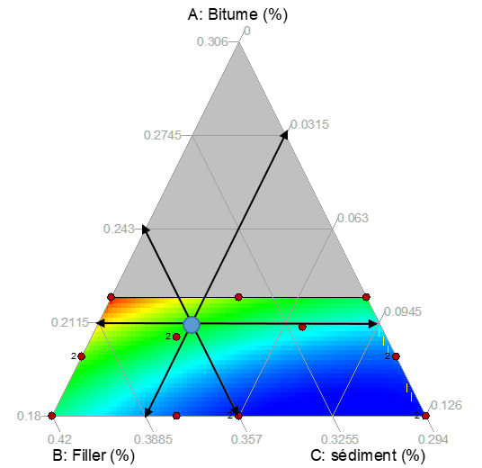
Results
22
Validation of the model
Sediment | Av; Indentation predict (1/10)mm | 95% confidence (1/10)mm | Av. Experimental Indentation (1/10)mm
ASL | 75.68 | [73.24-79.89] | 73.14
ARS | 69.47 | [64.45-73.85] | 65.75
MEL | 64.01 | [59.43-70.12] | 60.98
NSL | 59.22 | [53.16-66.22] | 55.17
ASLT | 80.01 | [77.32-83.11] | 81.55
ARST | 77.10 | [74.37-88.45] | 75.42
MELT | 68.70 | [63.52-73.25] | 64.87
NSLT | 60.19 | [54.71-65.12] | 57.57
MELC | 78.29 | [74.61-82.23] | 77.26
NSLC | 72.81 | [67.32-77.36] | 69.14
ASLB | 99.31 | [92.89-99.27] | 100.03
ASLTB | 104.87 | [101.43-108.31] | 107.14
Mix based on 3,15% sediment (8% substitution de filler )
35,7 % filler 21,15% bitumen 40% sand
Average of the indentation values within the 95 % confidence interval
All models are validated, Indentation predictions with high accuracy

Slide 23
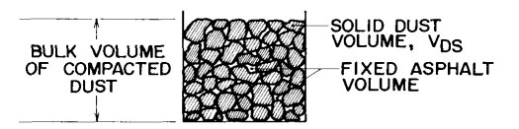
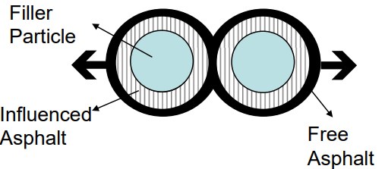
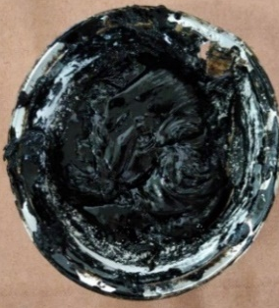
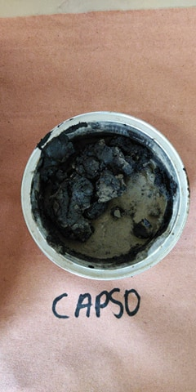
Results
23
Interpretation
Bitumen absorption is more important for filler sediments
A slight improvement/decrease in this absorption of lime-treated sediments
A significant decrease in the absorption of calcined sediments

Slide 24
Results
24
Correlation indentation VS organic matter
Correlation indentation VS Rigden Voids
A strong correlation between indentation and organic matter R2=84%
A strong correlation between indentation and inter-granular porosity (RV)

Slide 25
Conclusions and perspectives
25
The flash calcination improves the quality of fillers from waste
The lime-treatement sediments have a slight improvement
A softer bitumen grade can give satisfactory results
The IA can be use to predict the indentation values
Web site
https://www.sedilab.com/portfolio-item/sediasphalte/

Slide 26


26
Thank you for your attention !!
Walid MAHERZI
Assistant professor at IMT Nord Europe,
France
walid.maherzi@imt-nord-europe.fr
@WalidMAHERZI
logos
Notes:
Thank you everyone and i will be happy to take questions

